Slide 1

Amazon Global Business Analytics
Power BI-based Global Dashboard
Amazon

Slide 2


Project Overview

Slide 3



Why Amazon?
World’s largest e-commerce marketplace
Global scale → Need for BI-driven decisions
Millions of transactions daily

Slide 4

Project Overview
Overview:
Power BI-based Global Dashboard
Covers Sales, Profit & Loss, Customer Behavior
Provides real-time 360° business visibility

Slide 5
Project Context
High data complexity in e-commerce
Regional + product-level performance gaps
Customer profitability unclear

Slide 6


Business Problems
No clarity on loss-making products
Regional performance gaps
Customer profitability blind spots

Slide 7
Project Objectives
01
Visualize global sales trends
02
Identify profit vs. loss products
03
Segment & market analysis
04
Real-time KPI tracking

Slide 8
Key Considerations
Product Overview
High transaction volumes
Fragmented profitability insights
Dynamic filters needed (Year, Region, Segment)
Customer-level profitability focus

Slide 9
Target Audience
CXOs & Leadership → Growth strategy
Business Analysts → Deep-dive analysis
Operations Teams → Track returns & demand
Sales & Marketing → Identify profitable markets

Slide 10

Solution Highlights
Integrated Power BI dashboard
Real-time KPI monitoring
30%
Region-wise, product-wise, customer-wise analysis
70%
Interactive filters &
drill-downs

Slide 11
Dashboard Visuals (KPIs)
Sales Projection → 4M
Units Sold → 3,418
KPI Value → 61K
Return Orders → 371

Slide 12
Sales Insights
Sales by Market → Europe (31.9%), USCA (27.45%)
Sales by Segment → Consumer ~50% share
Sales by Region → Europe & USCA lead

Slide 13
Profit Insights
Canon Printers → +16K profit
Cubify Cube → -3.8K loss
Top Customers → Rick Wilson (3.5K), Math Reese (2.3K)

Slide 14
Filters & Interactivity
Year Filter (2012–2015)
Segment Filter
Drill-down + Tooltips
Region Filter

Slide 15


Tools & Technologies
Data Analysis
DAX → KPI calculations
Data
Excel/CSV → Raw data source
Power BI → Dashboard design
Power Query → Data cleaning

Slide 16


Business Takeaways
Europe & USCA = top-performing markets
Consumer = biggest sales contributor
Few products driving losses
Top customers = key profit drivers
Business
Finance
Performance

Slide 17
Strategic Recommendations
Customer retention via loyalty programs
Remove/optimize loss-making products
Strengthen Consumer Segment
Focus on Europe & USCA
Reduce return orders with better QC

Slide 18
Future Scope
66＋
Application Scenario
Predictive analytics for demand
Geo-mapping visualization
Mobile BI dashboards
68＋
AI-driven customer segmentation

Slide 19
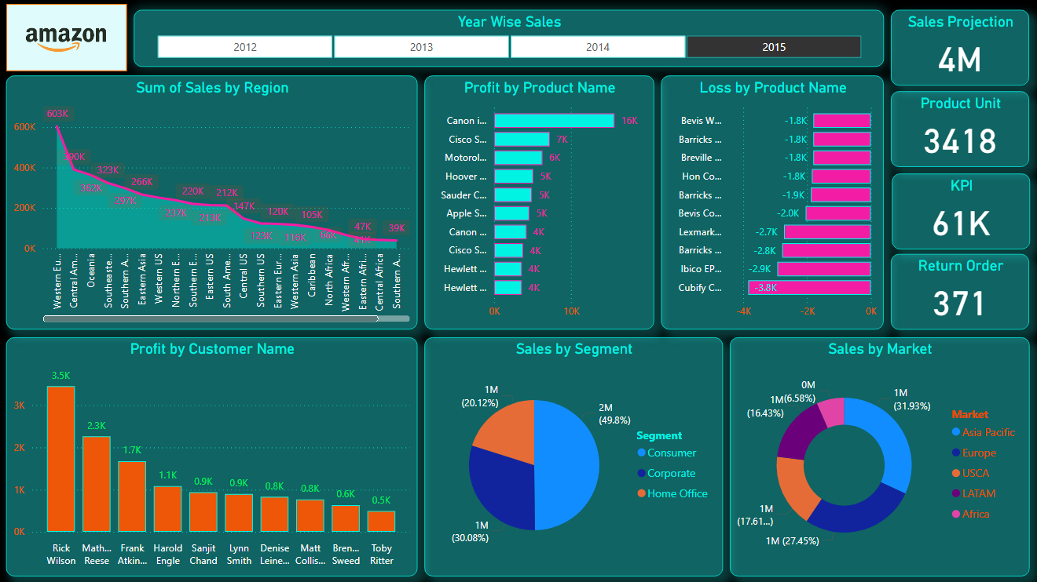
Final Dashboard Snapshot

Slide 20
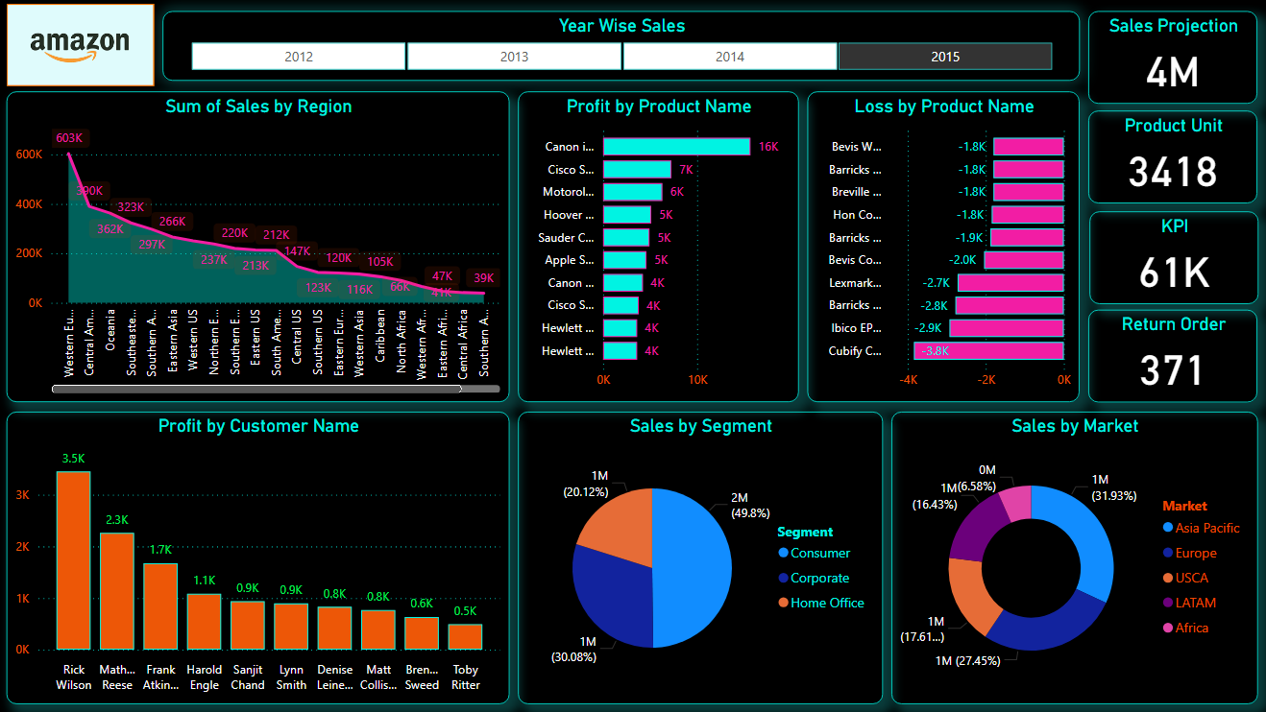
Final Dashboard Snapshot

Slide 21
THANK You!
Every great presentation is complete with a great audience — and that’s you!

